Slide 1
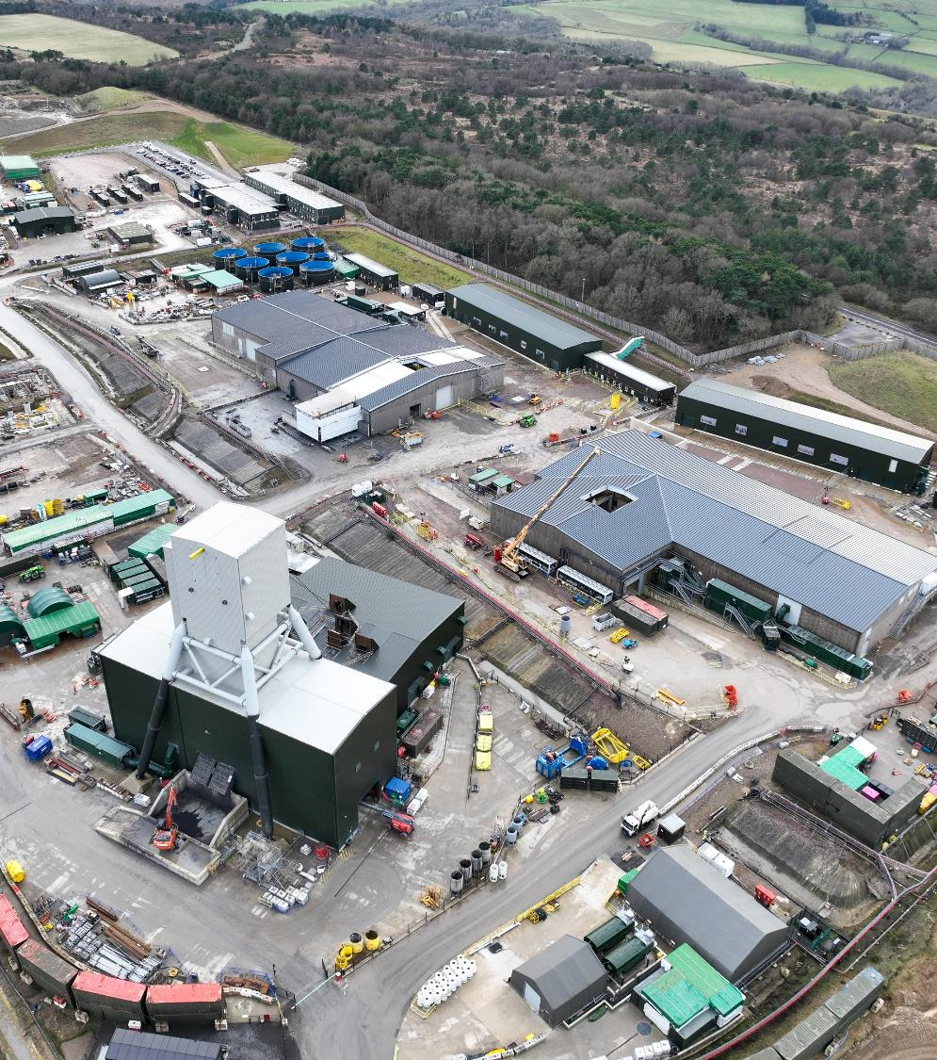
Liaison Group Forum Woodsmith Project update
April 2025

Slide 2

Granulation capacity
Bran Sands expansion
29.4 km
-712m
-811m
Shafts Mine | 1,600m access & hoisting shafts Mechanised underground operation
Underground conveyor | 37km underground tunnel
Processing & port facilities | Materials Handling Facility Priority access export facilities
Anglo American
Not to scale. Graphic and information is illustrative only as studies are ongoing & subject to Board approval
Notes:
This image shows the scope of the project. Red is current progress.
The key features of this slide are as follows:
First: The two ~1.6 kilometre deep shafts, known as the service shafts and production shafts. These will be sunk to the final elevation by our shaft sinking contractor Redpath. When done these are expected to be the deepest shafts in Europe. From a status standpoint and where we sit today, the service shaft is currently at 744 metres and making good progress since starting. The production shaft started around April 2023 and is currently at 510 metres and has the benefit of many of the lessons from the service shaft. We typically see more daily meters from the production shaft due to the service shaft lessons being applied to the production shaft. We are very pleased with the progress made on both shafts since Redpath started in 2022.
Second: Mineral transport system (MTS) shaft and MTS level underground facilities to handle the Polyhalite or which comes up the production shaft and transfer it onto the conveyor in the tunnel
Third: the tunnel… a 37 kilometre underground transport route used to carry material from the mine to the handling facility at the port. Today we are at around 27.5 kilometre in from the Port. The team on the tunnel continue to exceed expectations and last year we broke the world record for the longest single drive TBM
Next: we have two “smaller” intermediate access shafts – Lockwood Beck, Ladycross – needed for maintenance and ventilation, with both now fully excavated and only Ladycross to finish out the fit out in the coming months. The Lockwood Beck shaft is in operation and you will visit this later.
To complete the picture – we have materials handling facility and port at Teesside where the Polyhaylite will be granulated and product loaded out for shipping. You will get the full pit to port experience today

Slide 3
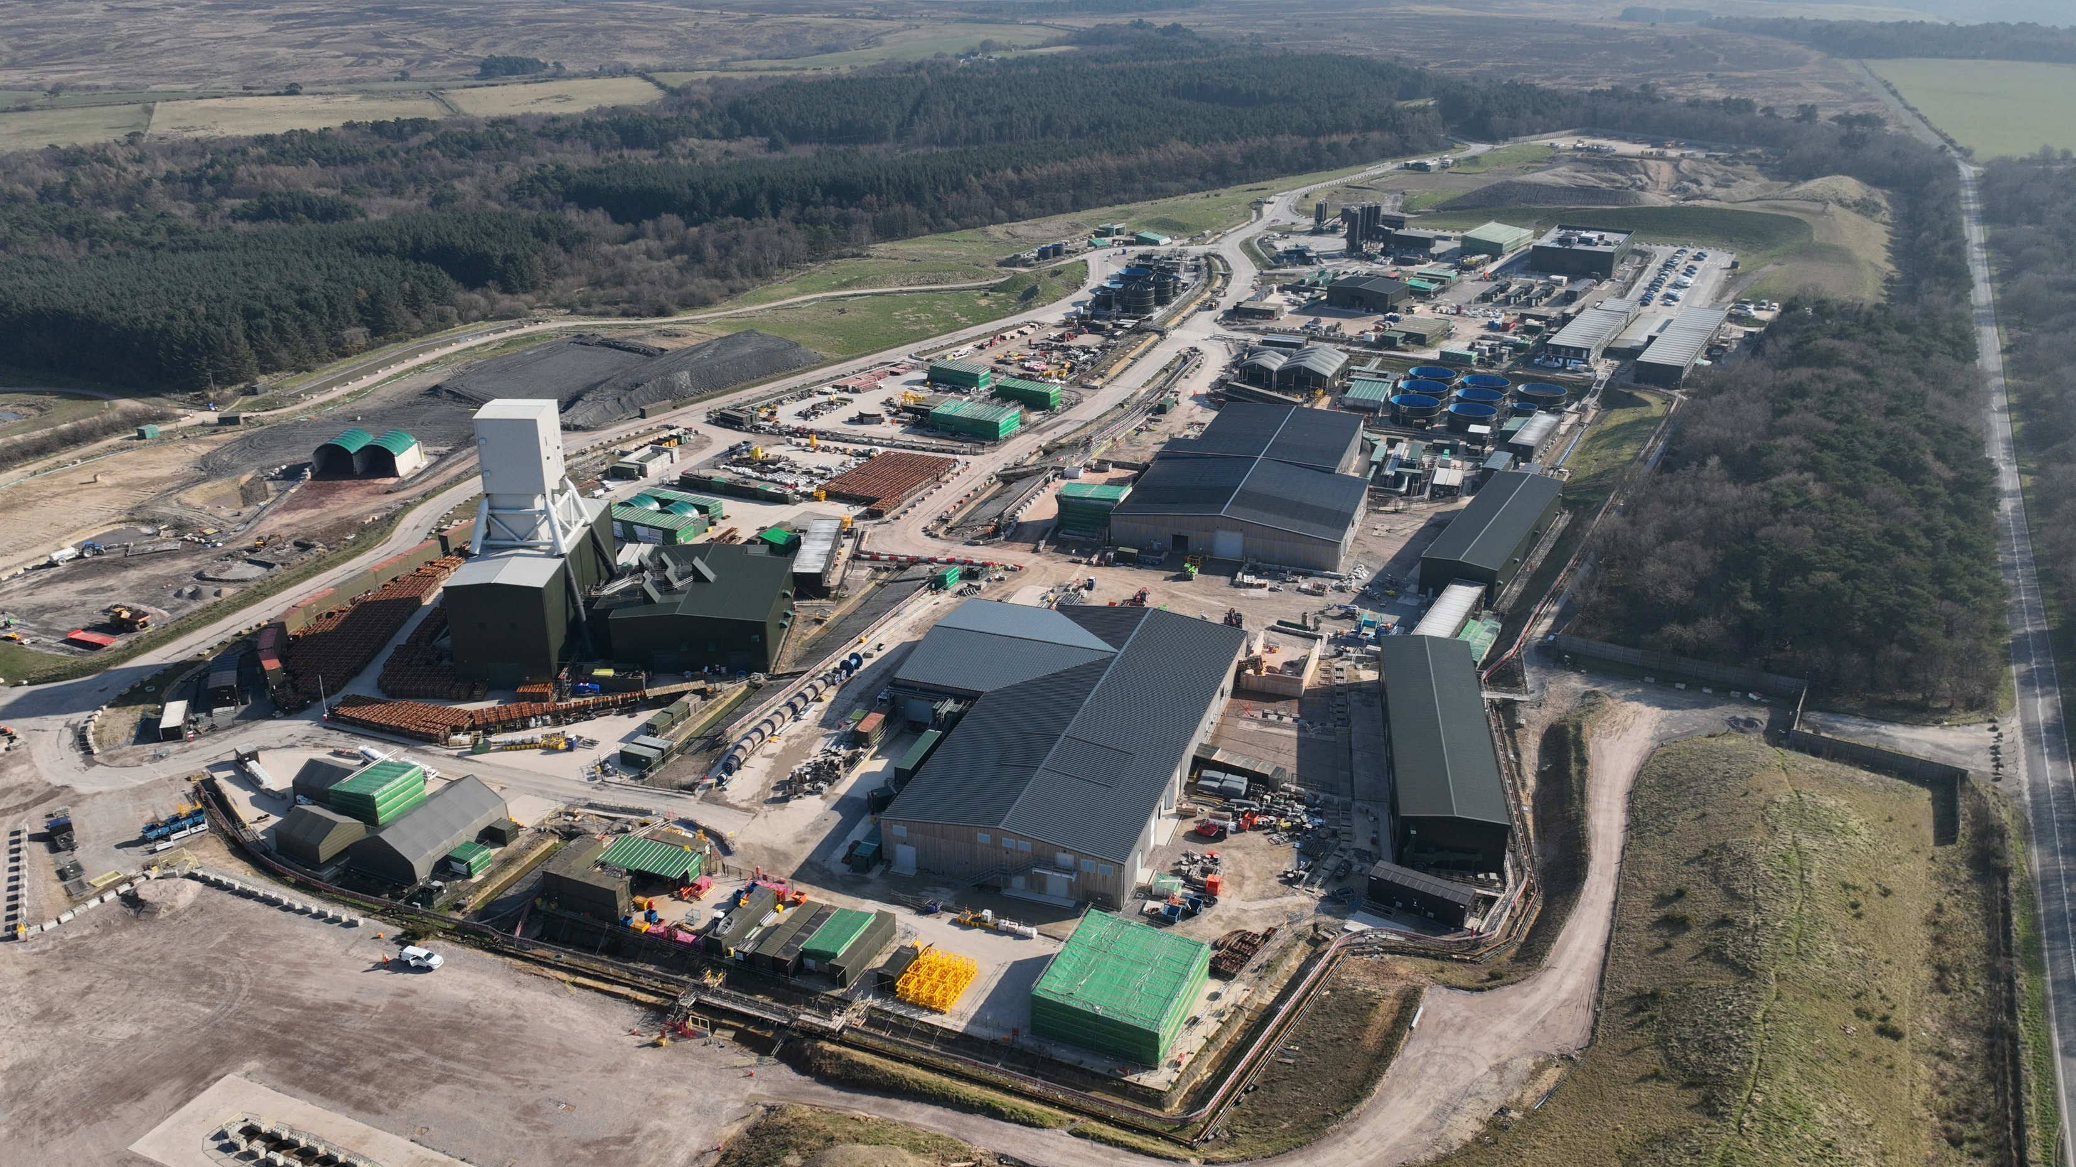

Slide 4
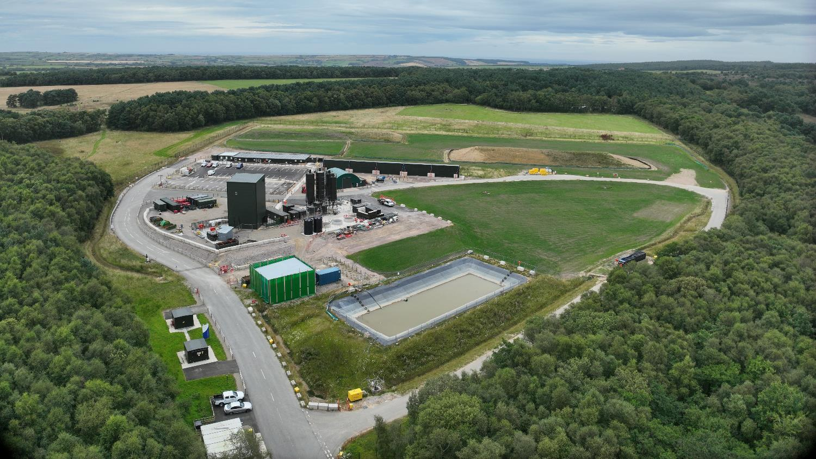

Slide 5
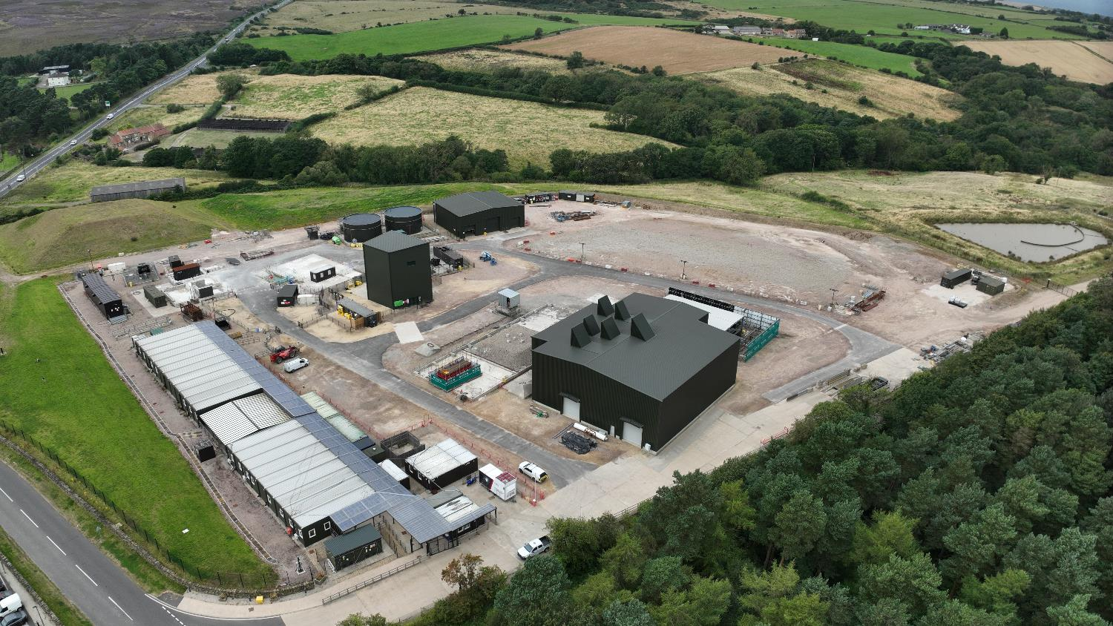

Slide 6
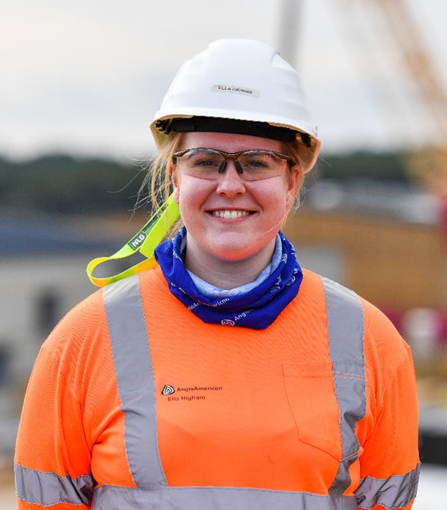
Direct economic benefits: construction
Jobs
1,100 people working on the Woodsmith Project
820 are local – 75% of the workforce
  480 Tees Valley
  340 North Yorkshire
Slowdown
c.800 job losses
  275 Tees Valley
  150 North Yorkshire
330 people supported by Social Response Plan
Growing the regional economy
£1.8 billion added to the regional economy of Yorkshire and the North-East since construction started
£337 million in 2024
Notes:
Whilst we are setting ourselves up to make a long-lasting economic impact, we are already delivering significant benefits…
Jobs
1,650 people working on the project, who are based here – breakdown by site **as of Feb 2023**
1,000 local – define – something we really pleased about. In excess of our forecast
Contractors really pleased about availability of transferable skills – particularly Teesside
But of course we wouldn’t expect to find all the skills we need locally
450 are form the wider UK – 200 from a variety of countries with the mining and specialist shaft sinking and tunnelling experience we need – Canada, Australia, South Africa, Austria, Eastern Europe
Includes around 80 from Belarus, which was the last country where SBRs were used (shafts 3 and 4). We’ve really benefited form that experience
Approximately 1,000 high-skilled jobs when project id operational
Apprentices
We are proud of our apprenticeship programme – Ella one of our first cohort of 15 for which there was over 1,000 applicants. Successfully graduated couple of months ago
Last year we launched our cyber security apprenticeship centre of excellence located in this building. We took on 7 last year with a further 6 starting last month
Local procurement
Engaging local businesses in the supply chain is another way we can benefit the local area – safeguard existing jobs and create new ones.
Spent £120 million sourcing goods and services from companies in the region last year, currently in process of recruiting a local procurement manager to increase that number moving forward.
Growing regional economy
Since the construction stared the Woodsmith Project has generated an additional £1.2bn to the regional economy of Yorkshire and the North East. £222m of this was last year.
will also have an impact at a national level.

Slide 7
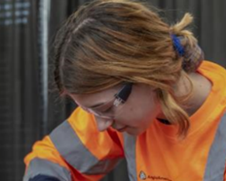
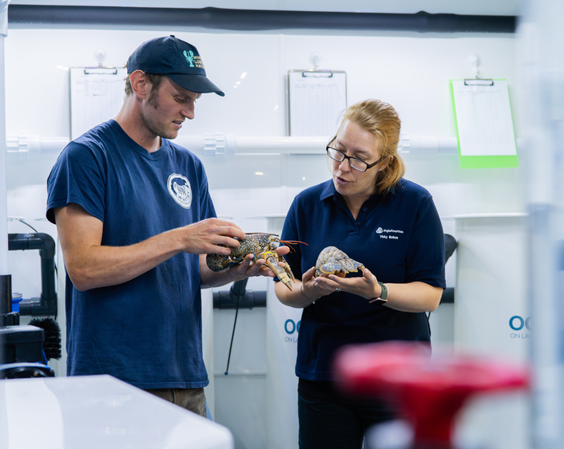
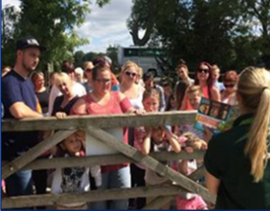
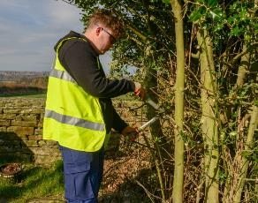
Thriving Communities Programme
Launched in 2021, aims to address local challenges and realise opportunities
Education | Livelihoods | Health | Neighbourhoods
Promote STEM careers and curriculum 28,114 students engaged 192 events Improving outcomes for disadvantaged students Achieve programme supports 150 students in 5 secondary schools | Connecting people to opportunities 151 new businesses created through start-up programme 271 people into employment Supporting businesses in key local sectors to grow 1900+ businesses supported | Improve the emotional resilience and well-being of young adults Launched two-year pilot to support 15-21 year olds 126 people supported 2024 | Improve the community environment and facilities in areas closest to our sites 176 community projects delivered Support community events Fund c.10 events per annum

Slide 8
Any questions?

