Slide 1
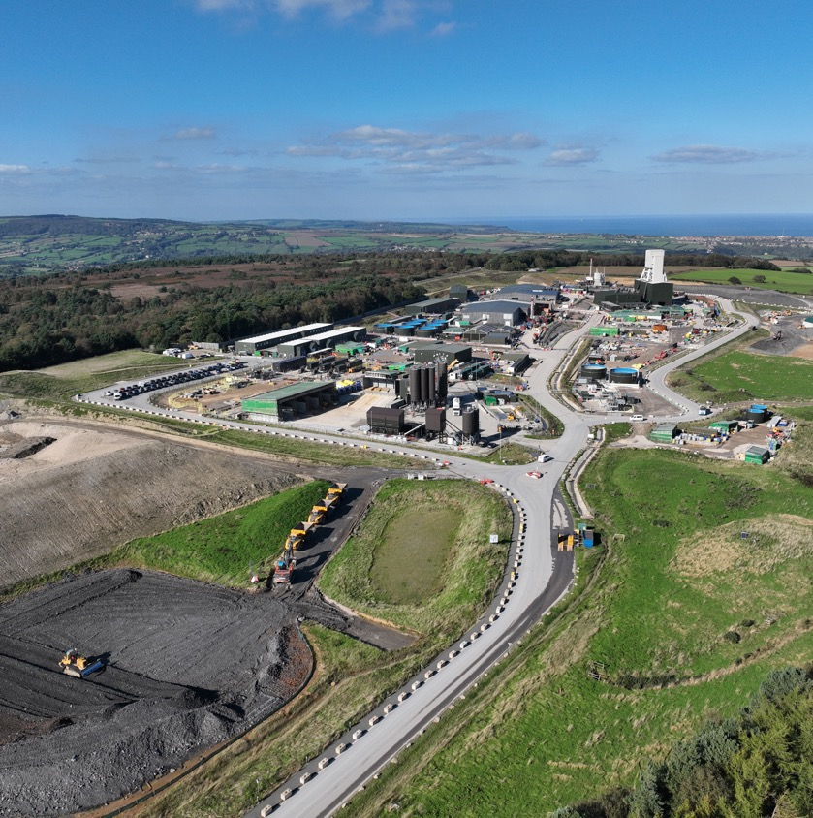
Liaison Group Forum
July 2024

Slide 2
Construction slowdown overview
Continue sinking Service Shaft to prove our ability to progress through the Sherwood Sandstone.
Place the Production Shaft and MTS shaft and station on care and maintenance.
Complete the construction of the Lady Cross cross-passage and the maintenance of the TBM, including the excavation of the timber heading, to enable cutterhead refurbishment.
TBM will restart at a significantly reduced rate
All other project work will be stopped and put into care and maintenance at safe, logical completion points depending on the area and scope.

Slide 3
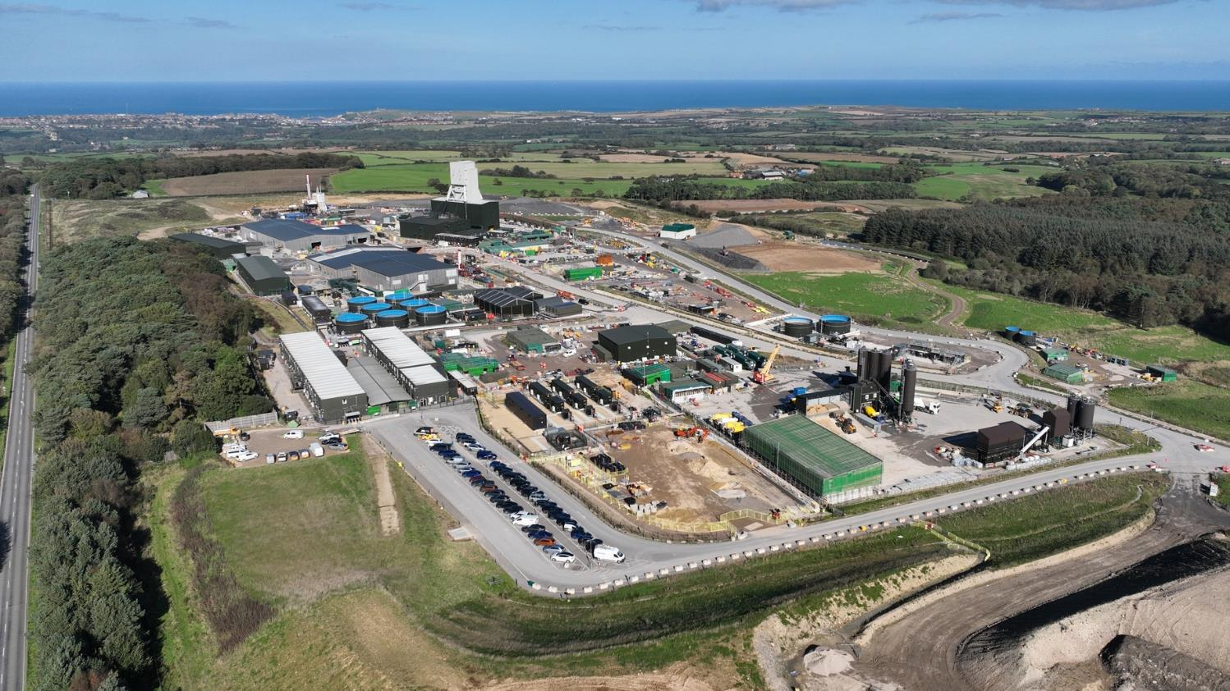
Woodsmith mine (construction)
Woodsmith mine (construction)
Woodsmith mine (construction)
MTS shaft
Service shaft
Label
Do we have angle to match the next slide (ie. From other side)
Production shaft

Slide 4
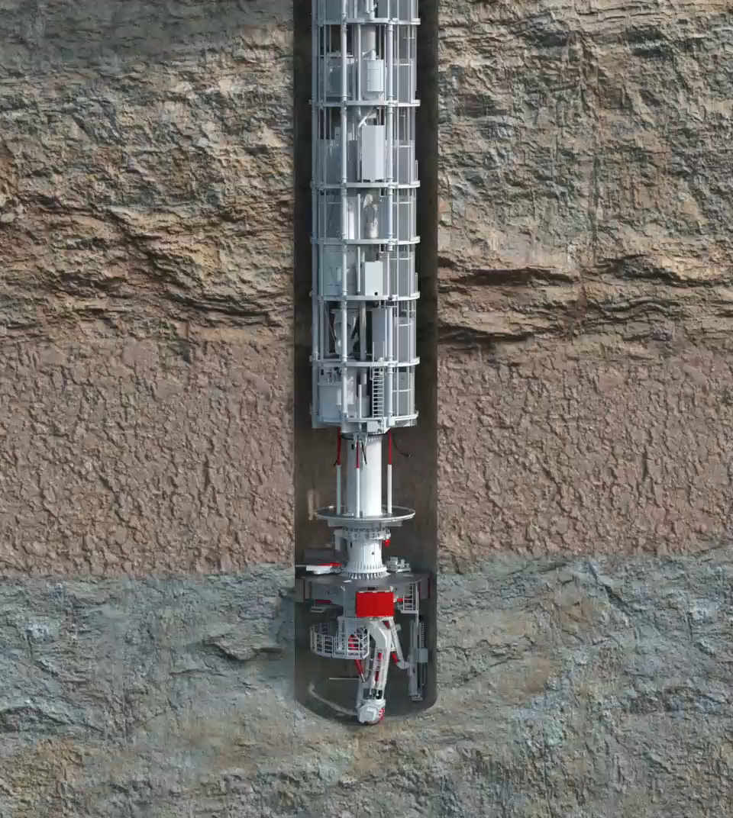
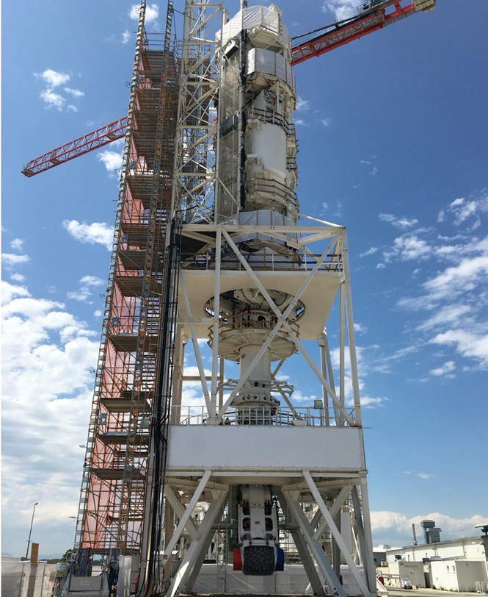
Shaft Boring Roadheader

Slide 5
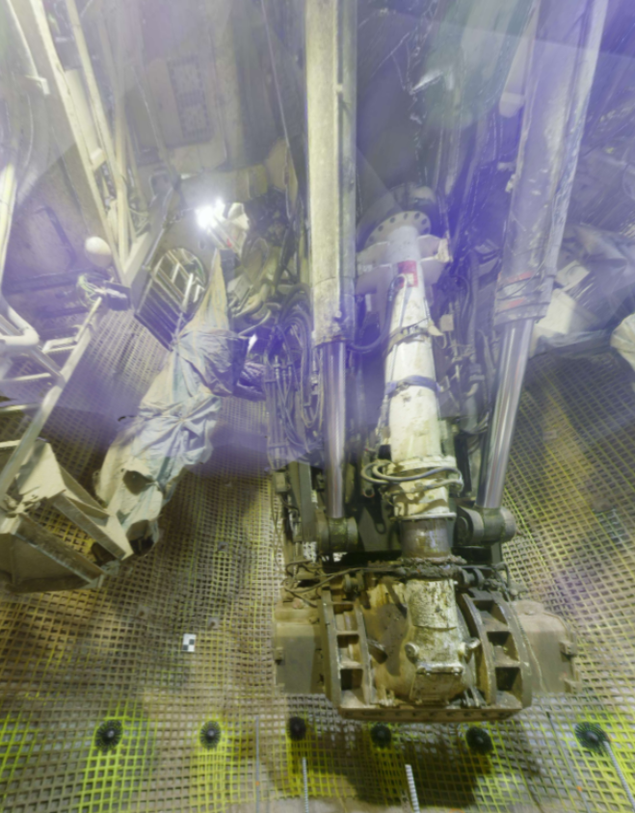
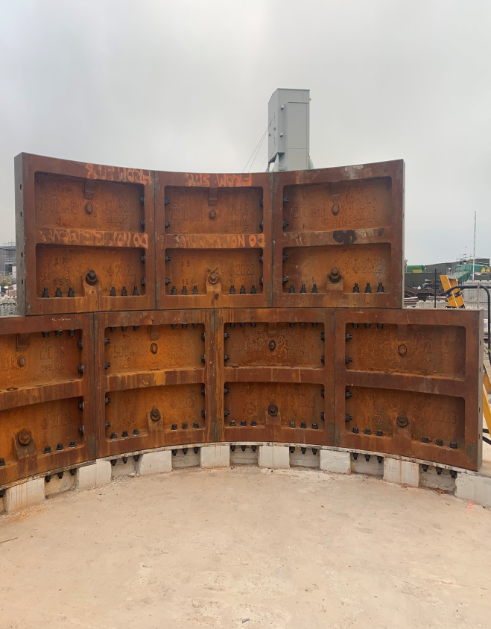

Slide 6
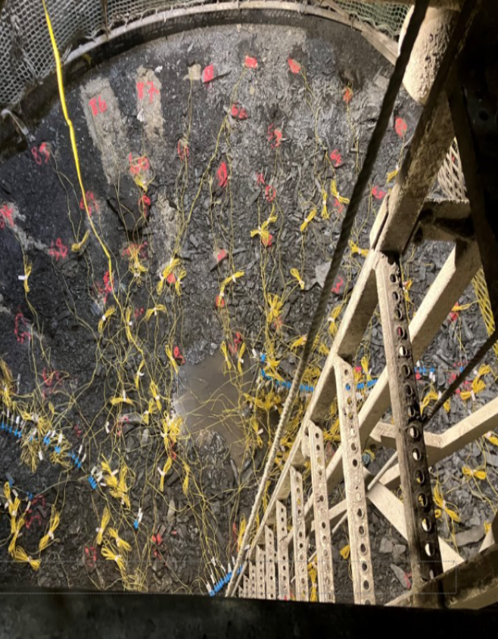
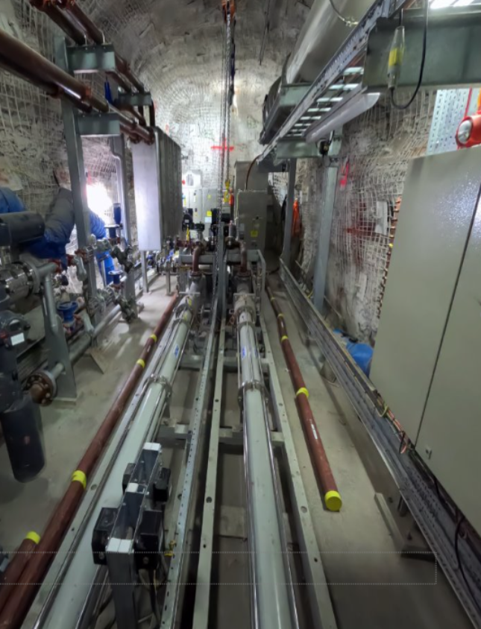

Slide 7
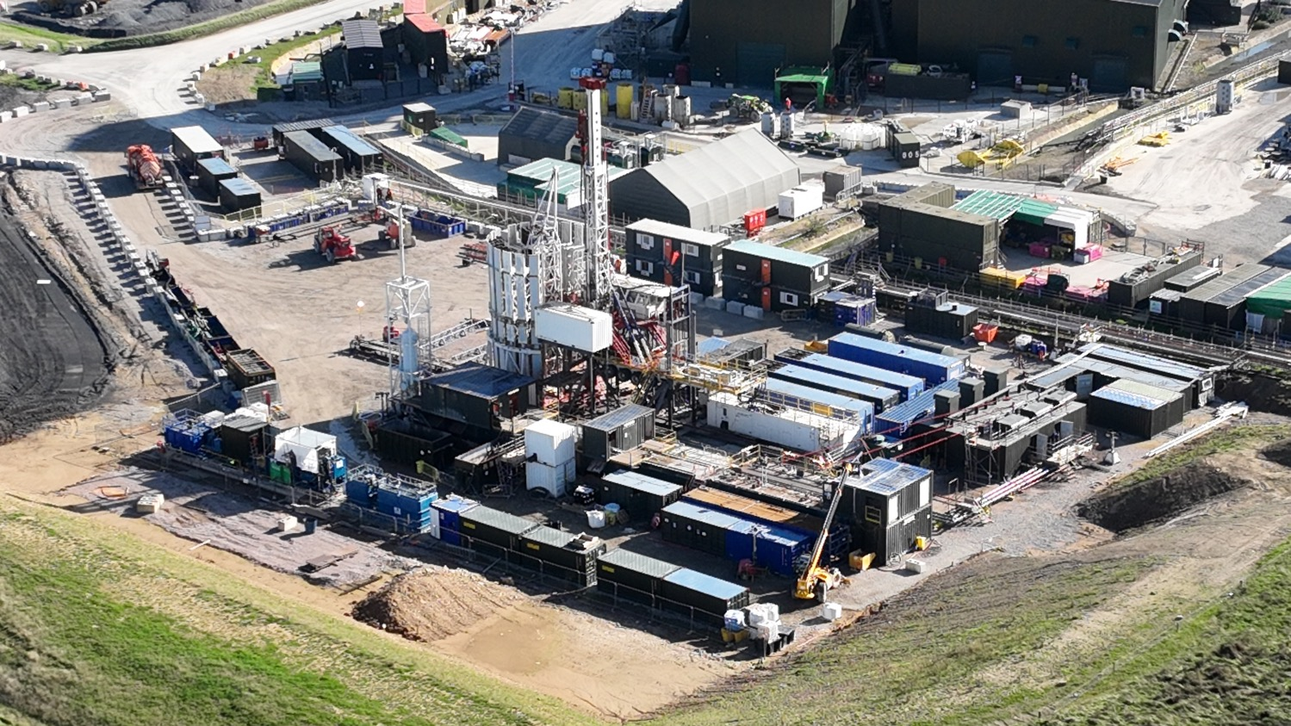

Slide 8
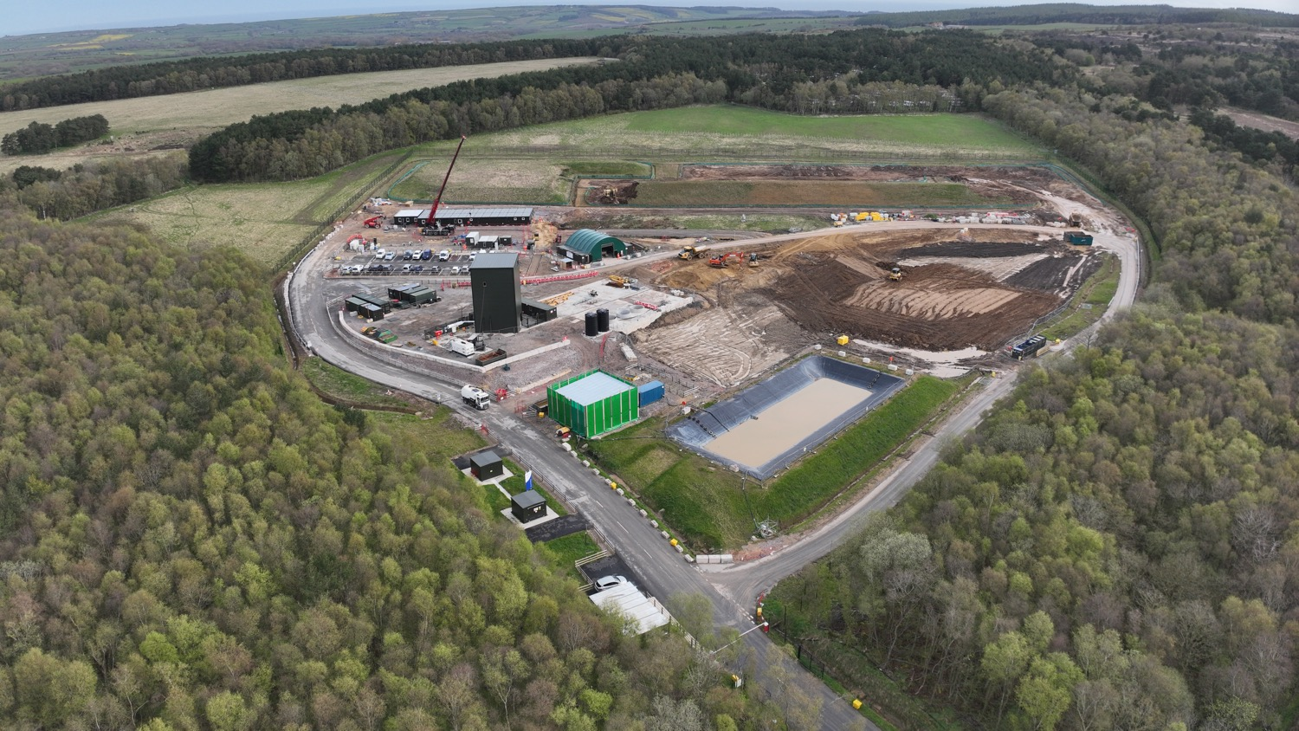

Slide 9
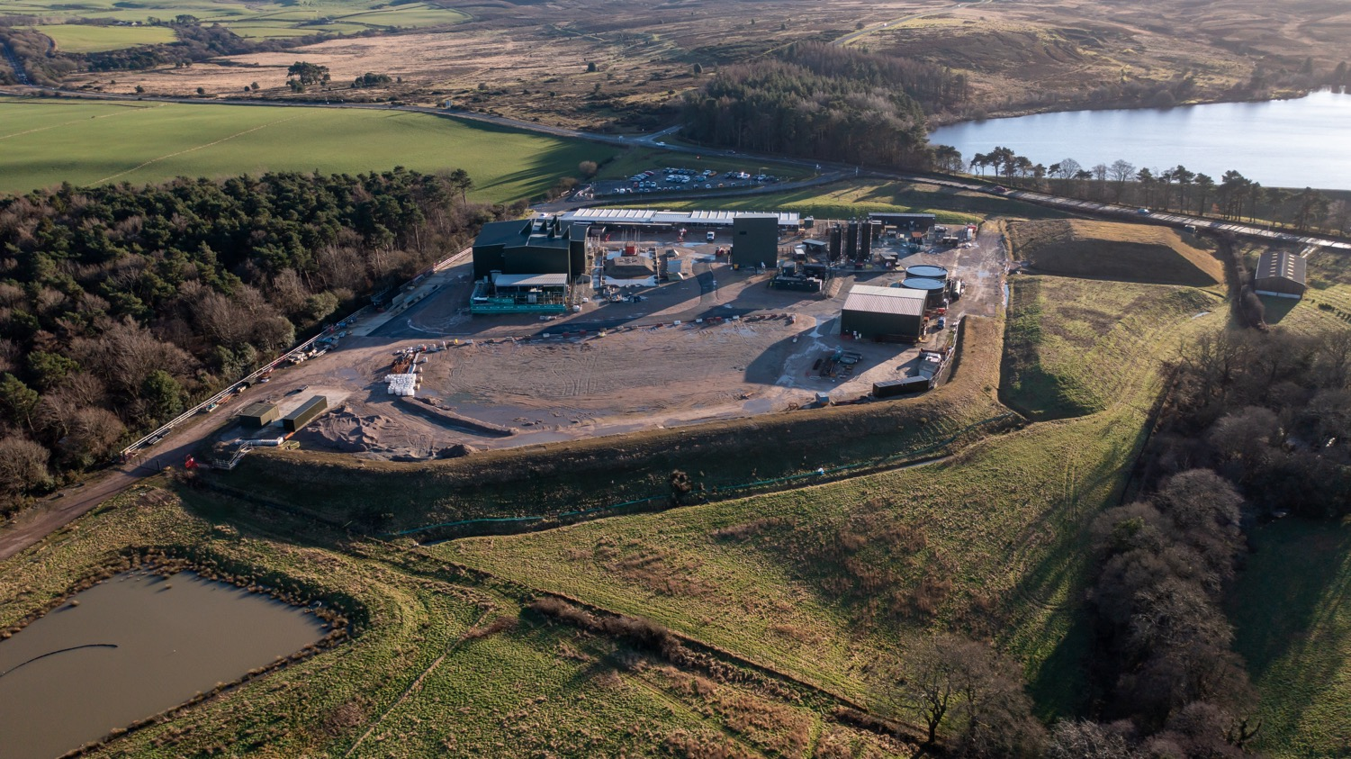
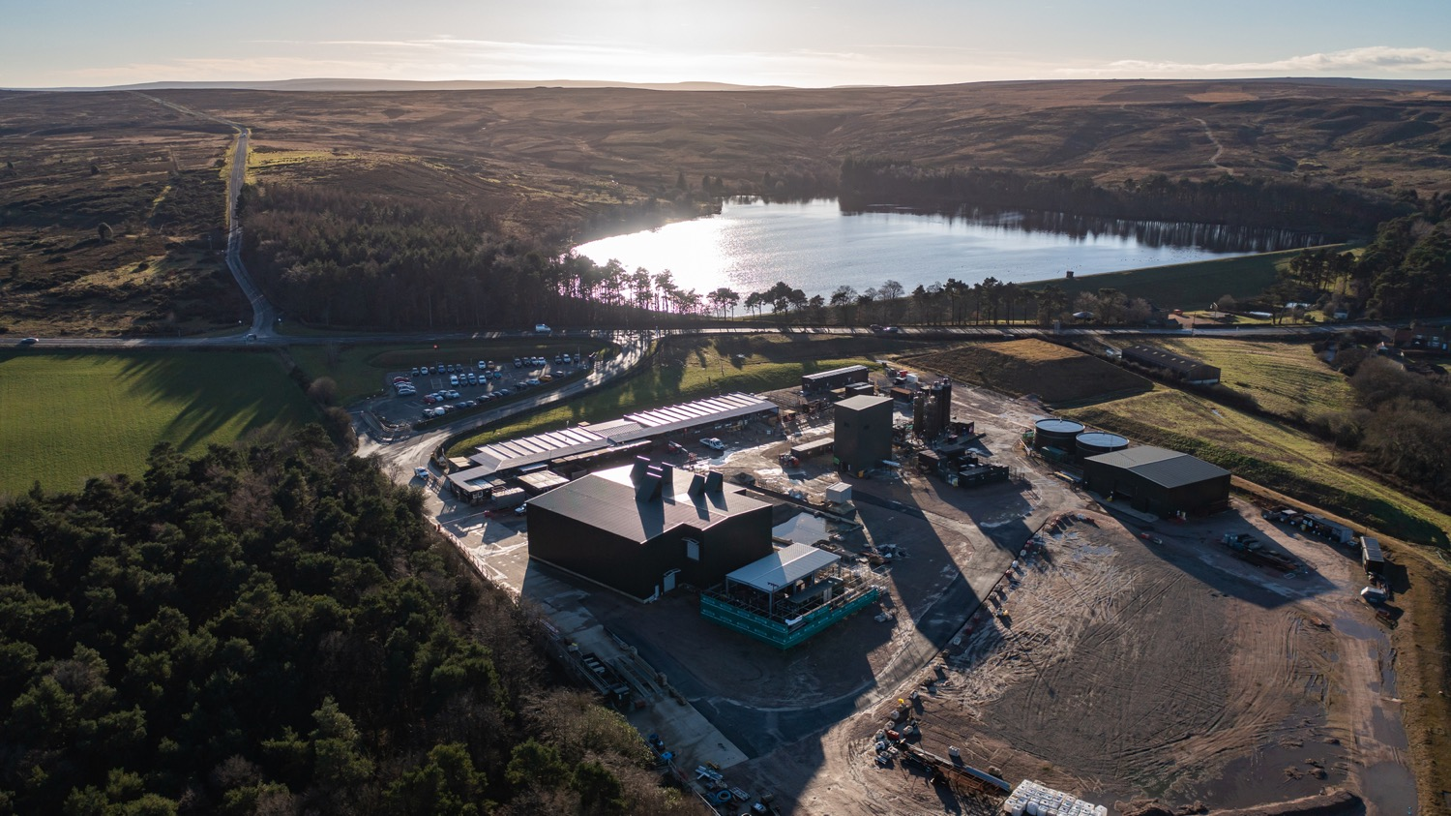
Lockwood Beck

Slide 10
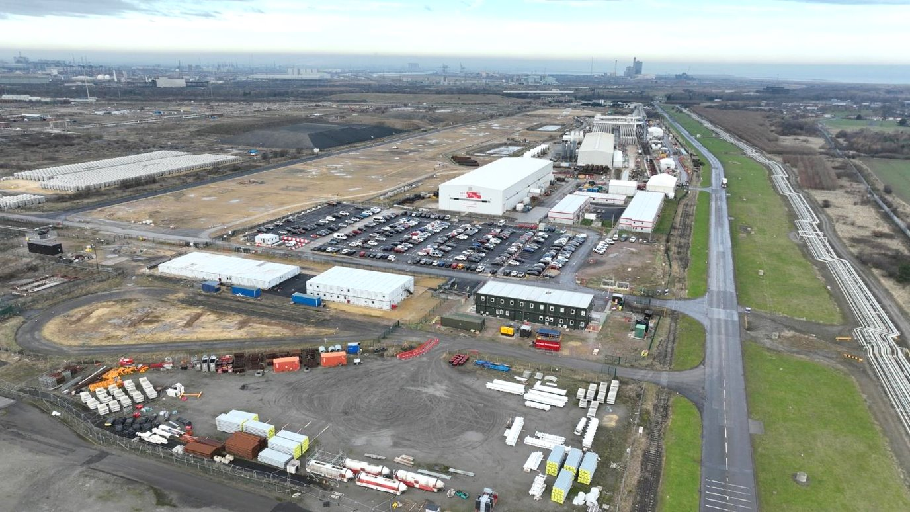
Wilton International

